Slide 1
Understand the GPIO controller and its functionalities

Slide 2
General Purpose Input Output (GPIO)
GPIO pins most commonly used in toggling LED’s and handling press and release events of the buttons.
But, GPIO’s are not limited to only this applications.
GPIO’s are used in many other applications.

Slide 3
General Purpose Input Output (GPIO)
Applications of GPIO:
Reading/Writing digital signal
Issuing interrupts
Generating triggers for the external components
Waking up the processor
MCU
Enable Line
Pin
Output buffer
Input buffer
GPIO Pin
Notes:
Self Created

Slide 4
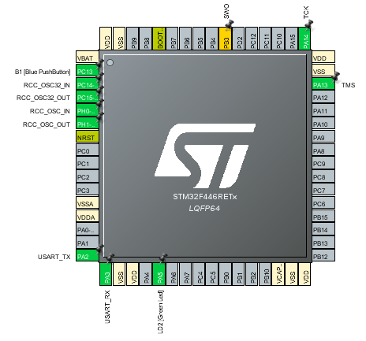
General Purpose Input Output (GPIO)
GPIO Port and Pin:
GPIO port is a collection of fixed number of I/O pins (i.e., in STM32 Nucleo board there are 16 pins in each port)
Each pin represented by the corresponding bit of the GPIO port registers
PA 8 | PA 9 | PA 10 | PA 11 | PA12 | PA13 | PA14 | PA15
GPIO Port A
PA 0 | PA 1 | PA 2 | PA3 | PA4 | PA5 | PA6 | PA7
Notes:
Self created
Taken from STM32CubeMX IDE tool

Slide 5
GPIO Input & Output Mode
+VCC
+VCC
T1
Source
Source
T1
gate
gate
PMOS
PMOS
Pin
Pin
Drain
Drain
gate
NMOS
NMOS
T2
gate
Source
T2
Source
GND
GND
Output Buffer
Input Buffer
Notes:
Self Created

Slide 6
GPIO Pin Hi-Z State
+VCC
Hi-Z state
By default all the GPIO pins are in floating (Hi-Z) state
It results in current leakage
T1
Source
gate
PMOS
Pin
Hi-Z state
Drain
NMOS
gate
T2
Source
GND
Input Buffer
Notes:
Self Created

Slide 7
GPIO Input Mode with
Internal Pull-Up/Pull-Down
To avoid Hi-Z state internal pull-up/pull-down registers will be activated in GPIO input mode
+Vcc
Pin
Ri
Ri
Pin
GND
Input Buffer with Pull-up Register
Input Buffer with Pull-down Register
Notes:
Self Created

Slide 8
GPIO Output Mode with
Open-Drain State
+VCC
In open-drain state PMOS transistor will be turned off.
So, output state can be either GND or floating
T1
Source
gate
PMOS
Drain
Pin
gate
NMOS
T2
Source
GND
Notes:
Self Created

Slide 9
GPIO Output Mode with
Open-Drain Pull-up
+VCC
+VCC
Ri
Re
Pin
Pin
gate
NMOS
NMOS
gate
T2
T2
Source
Source
GND
GND
Open-drain with internal pull-up
Open-drain with external pull-up
Notes:
Self Created

Slide 10
GPIO Output Mode with Push-pull Configurations
By default GPIO output mode is in push-pull configurations
Here, no need of any internal/external pull-up/pull-down registers.
Output will be pulled active low/high using these transistors
+VCC
T1
Source
gate
PMOS
Pin
Drain
gate
NMOS
T2
Source
GND
Output Buffer
Notes:
Self Created

Slide 11
Understand the SPI protocol

Slide 12
SPI Protocol
SPI stands for (Serial Peripheral Interface)
SPI bus allows communication between one master and one or multiple slave devices.
SPI Bus
Master
MCU
Serial Clock
SCLK
SCLK
Master Out Slave In
Slave
(Sensors, EEPROM, SD CARD, Display, Wifi, BT, etc)
MOSI
MOSI
Master In Slave Out
MISO
MISO
gpio1
Slave Select
SS
Notes:
Self created

Slide 13
SPI Protocol
There are 4 I/O pins dedicated to SPI communication with the external devices.
MISO
It is used to receive data in master mode which is transmitted from slave mode.
MOSI
It is used to receive data in slave mode which is transmitted from master mode.
SCLK
Input pin for SPI slaves and serial clock output pin for SPI master
SS/NSS/CS (Slave Select/Chip Select)
It is used to select a particular slave device for communication.

Slide 14
SPI Protocol
Slave has to support for SPI communication.
Master uses one of its GPIO pin to pull the SS line to the ground to communicate with a particular slave device.
Master
MCU
Serial Clock
SCLK
SCLK
Master Out Slave In
Slave
(Sensors, EEPROM, SDCARD, Display, Wifi, BT, etc)
MOSI
MOSI
Master In Slave Out
MISO
MISO
gpio1
Slave Select
SS
Notes:
Self created

Slide 15
SPI Protocol
Minimal SPI communication
When there is only one master and one slave, there is a possibility of reducing the lines for communication in SPI based on the application design.
Master
MCU
Serial Clock
SCLK
SCLK
Master Out Slave In
Slave
(Sensors, EEPROM, SDCARD, Display, Wifi, BT, etc)
MOSI
MOSI
MISO
MISO
gpio1
SS
Notes:
Self created

Slide 16
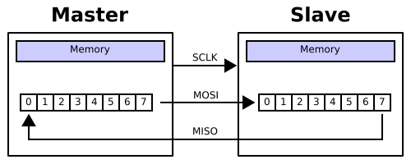
SPI Protocol
SPI Hardware
Notes:
File:SPI 8-bit circular transfer.svg - Wikimedia Commons

Slide 17
SPI Protocol
Customizing SPI Bus Configurations
SPI bus can be configured in different modes based on target slave device and application requirements.
SPI full-duplex communication
Clock
SCLK
SCLK
Up to 16-bit shift registers
MISO
MISO
Up to 16-bit shift registers
MOSI
MOSI
NSS
NSS
Notes:
Self created

Slide 18
SPI Protocol
SPI half-duplex communication
Clock
SCLK
SCLK
Up to 16-bit shift registers
MISO
MISO
Up to 16-bit shift registers
R
MOSI
MOSI
NSS
NSS
SPI Simplex communication
Clock
SCLK
SCLK
MISO
MISO
Up to 16-bit shift registers
Up to 16-bit shift registers
MOSI
MOSI
NSS
NSS
Notes:
Self created

Slide 19
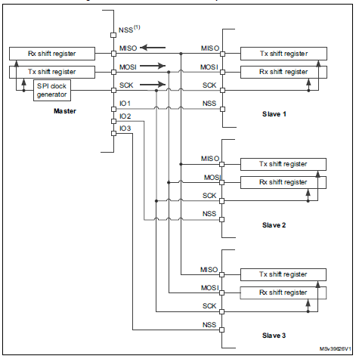
One Master and Multiple Slave
In this case, master’s NSS pin will not be used and it’s connected to +VDD to avoid noise.
And Master’s gpio pins are used to select the slave devices.
Notes:
STM32F446xx advanced Arm®-based 32-bit MCUs - Reference manual (pg no. 852)

Slide 20
Slave Select (NSS) pin Management
In slave mode, the NSS pin works as a standard “chip select” input and lets the slave communicate with the master.
In master mode, NSS can be used either as output or input.
as an input it can prevent multi-master bus collision
as an output it can drive a slave select signal of a single slave.

Slide 21
Slave Select (NSS) pin Management
Two types:
Hardware Slave Management
Software Slave Management

Slide 22
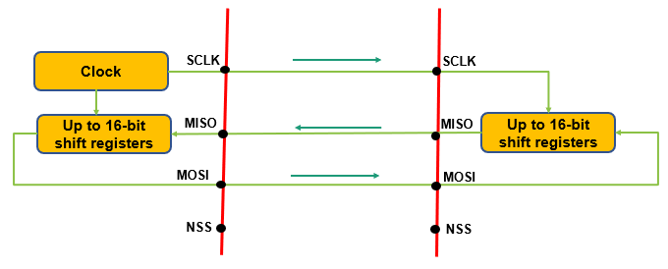
Slave Select (NSS) pin Management
Hardware or software slave select management can be set using the SSM bit in the SPIx_CR1 register:
Software NSS management (SSM = 1)
In this configuration, slave select information is driven internally by the SSI bit value in register SPIx_CR1. The external NSS pin is free for other application uses.
Notes:
Self Created

Slide 23
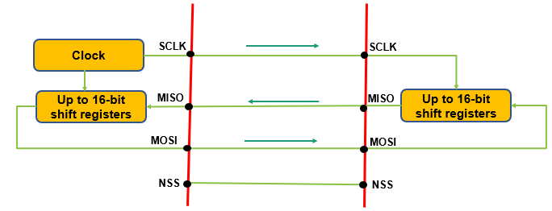
Slave Select (NSS) pin Management
Hardware or software slave select management can be set using the SSM bit in the SPIx_CR1 register:
Hardware NSS management (SSM = 0):
In this case, there are two possible configurations. The configuration used depends on the NSS output configuration (SSOE bit in register SPIx_CR1).
NSS output enable (SSM=0,SSOE = 1)
NSS output disable (SSM=0, SSOE = 0)
Notes:
Self Created

Slide 24
SPI Protocol
SPI Communication Format
SCLK PHASE (CPHA)
SCLK POLARITY (CPOL)
Data frame format (DFF)
Notes:
Self created

Slide 25
SPI Protocol
During SPI communication, data receive and transmit operations are performed simultaneously.
The serial clock (SCLK) synchronizes the shifting and sampling of the information on the data lines.
The communication format depends on the clock phase, clock polarity, and the data frame format (8-bit or 16-bit).
It is important to note that the master and slave needs to follow the same communication format to communicate.

Slide 26
SPI Protocol
CPOL (Clock Polarity)
When no data is transmitted, it controls the idle state value of the clock.
If CPOL bit is set, the SCLK pin has a high-level idle state.
If CPOL bit is reset, the SCLK pin has a low-level idle state.
CPOL = 1
CPOL = 0
Notes:
Self Created

Slide 27
SPI Protocol
CPHA (Clock Phase)
The CPHA bit controls at which clock edge of the SCLK(1st or 2nd) the data should be sampled by the slave.
Combination of CPHA and CPOL bits selects the data capture clock edge.

Slide 28
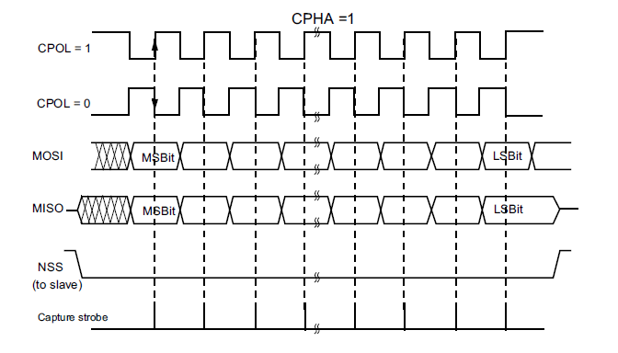
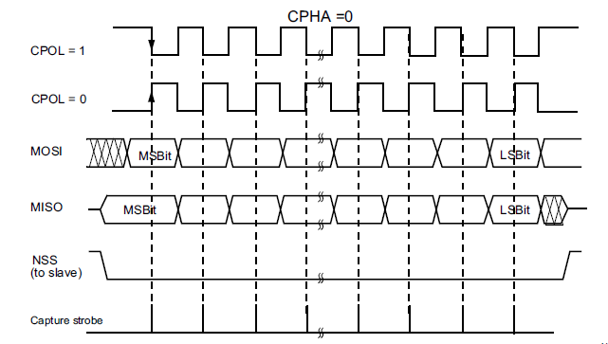
SPI Protocol
CPHA (Clock Phase)
Data will appear on the lines during 1st edge of the clock and capture happens at 2nd edge of the clock.
Data will appear on the lines during 2nd edge of the clock and capture happens at 1st edge of the clock.
Notes:
STM32F446xx advanced Arm®-based 32-bit MCUs - Reference manual (pg no. 856)

Slide 29
Understand the I2C protocol (Inter-Integrated Circuit)

Slide 30
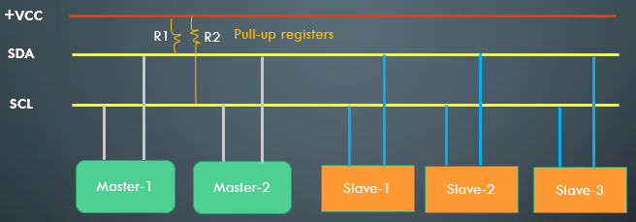
I2C protocol
I2C is a multi-master multi-slave communication protocol.
I2C needs just 2 pins to connect all the master and slave devices to it
Both SDA and SCL lines are bi-directional lines connected to positive power supply (+VCC) via pull-up registers. When the bus is free both the lines are pulled HIGH.
The output stages of the devices connected to the bus must have open-drain or open-collector configurations. Means, if you are using GPIO pins for I2C then it needs to be configured as open-drain or open-collector.
Notes:
Self Created

Slide 31
I2C Modes
Standard mode devices are not upward compatible; they cannot communicate with the devices of fast mode or above.
Fast mode devices are downward-compatible and can communicate with standard mode devices in I2C-bus system.
Fast mode devices are not upward compatible; they cannot communicate with the devices of fast mode+ or above.
Mode | Data Rate
Standard Mode | Up to 100 kbps
Fast Mode | Up to 400 kbps
Fast Mode+ | Up to 1 Mbps
High Speed Mode | Up to 3.4 Mbps
Notes:
Self Created

Slide 32
I2C Protocol Frame Format
R/W = 1 indicates master wants to read/receive the data from the slave
R/W = 0 indicates master wants to write/transmit the data to the slave
S
A7
A6
A5
A4
A3
A2
A1
R/W
ACK
D7
D6
D5
D4
D3
D2
D1
D0
ACK
P
Stop bit
7 or 10 – bit Address of the slave device
Data bits
Start Condition
Read/Write bit
Data Acknowledge bit
Address matching Slave acknowledges
Every byte put on SDA line must be 8-bit long
Each byte must be followed by an acknowledgement bit
Data is transferred with the MSB first
Notes:
Self Created

Slide 33
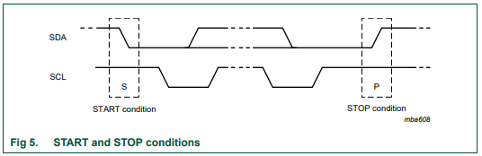
I2C START and STOP Conditions
A HIGH to LOW transition on the SDA line while SCL is HIGH defines a START condition.
A LOW to HIGH transition on the SDA line while SCL is HIGH defines a STOP condition.
After bus is released both the SDA and SCL lines stays HIGH
Notes:
UM10204 I2C-bus specification and user manual (nxp.com) (pg no. 9)

Slide 34
ACK and NACK Conditions
ACK means SDA line is pulled to LOW while SCL is HIGH.
NACK means SDA line is pulled to HIGH while SCL is HIGH.
When master receives NACK then either it abnormally terminates the transaction by generating STOP condition or generates repeated START condition to start a new transfer.
The acknowledgement takes place after every byte.
SCL
SDA
ACK
NACK
Notes:
Self Created

Slide 35
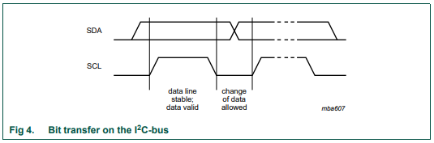
Data Validity
The data on the SDA line must be stable during the SCL is HIGH.
The HIGH or LOW state of the data line can only change when the clock signal on the SCL line is LOW. One clock pulse is generated for each data bit is transferred.
Notes:
UM10204 I2C-bus specification and user manual (nxp.com) (pg no. 9)

Slide 36
Points to Remember
The master generates all the clock pulses.
START and STOP conditions are always generated by the master.
The bus is considered to be busy after the START condition.
The bus is considered to be free after the STOP condition.
When the bus is free another master(if any) can get the chance to claim the bus.
The bus stays busy if a repeated START is generated without STOP condition.
Most of the MCU’s I2C peripherals supports both master or slave modes.

Slide 37
Points to Remember
We no need to configure the mode because when the device generates the START condition it automatically becomes master and when it generates the STOP condition it goes back to the slave mode.
Clock-stretching: When slave is busy in receiving data it will pull the SCL line to LOW so that master cannot send the data
Bus arbitration: It may happen that two masters start a transfer at the same time. During the transfer, the masters constantly monitor SDA and SCL. If one of them detects that SDA is low when it should actually be high, it assumes that another master is active and immediately stops its transfer. This process is called arbitration.

Slide 38
Difference between I2C and SPI

Slide 39
Difference between I2C and SPI
I2C | SPI
I2C have dedicated specification developed by NXP. | SPI have no dedicated specification so companies can develop their own spec
I2C is multi-master communication protocol | SPI don’t have any multi-master capability but manufacturers can achieve this from S/W side.
I2C needs only 2 pins for communications | SPI needs 4 or more pins for communications
I2C master communication with the slave based on address. | SPI master communicates with the slave based on Chip Select line.
I2C can operate on half-duplex mode | SPI can operate in full-duplex mode
I2C H/W automatically sends ACKs for every data byte received. | SPI H/W don’t have automatic ACK facility but from S/W side developer can program it
I2C supports maximum speed of 4MHz | SPI speed depends on clock (i.e., fpclk / 2)
I2C slave have control over clock (clock stretching feature) | SPI slave doesn’t have any control over the clock.
Notes:
Self Created

Slide 40
I2C Block Diagram

Slide 41
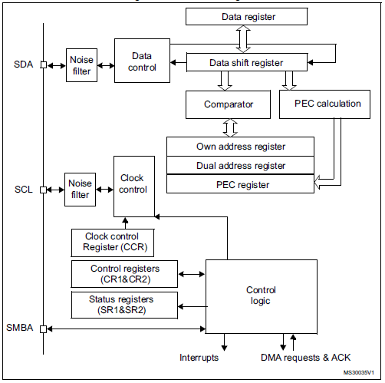
I2C Block Diagram
Notes:
STM32F446xx advanced Arm®-based 32-bit MCUs - Reference manual (pg no. 762)

Slide 42
Understand the UART protocol

Slide 43
USART vs UART protocol
UART
GSM/GPRS modules
USART
UART
MCU
MCU
Debugging
Smart Card
LIN
Mouse / Monitor
IrDA SIR
Printer
Modbus
Serial Ports
SPI Master
Universal
Synchronous
Asynchronous
Receiver
Transmitter
Universal
Asynchronous
Receiver
Transmitter
Notes:
Self Created

Slide 44
USART vs UART protocol
UART/USART converts parallel data into serial.
UART peripheral supports only asynchronous mode.
USART peripheral supports both synchronous and asynchronous mode.
There is no specific port for USART communication. They are commonly used in conjunction with protocols like RS-232, RS-434,USB, etc.
In case of USART for synchronous communication, the clock is sent separately from the data stream and no start/stop bits are used.

Slide 45
UART pins
UART
Data Control
Tx
Rx
Hardware Control
RTS
CTS
Notes:
Self Created

Slide 46
UART Communication
UART1
UART2
Data Control
Tx
Tx
Data Control
Rx
Rx
Hardware Control
RTS
RTS
Hardware Control
CTS
CTS
Once flow control is disabled RTS & CTS lines are ignored, so UART needs only 2 lines to communicate.
Notes:
Self Created

Slide 47
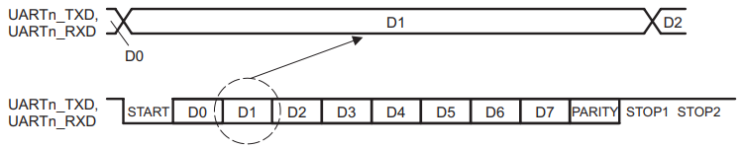
UART Frame Format
A frame refers to the entire data packet which is being sent or received during the communication.
Frame includes:
1 START bit
5, 6, 7, or 8 data bits
1 PARITY bit (optional)
1, 1.5, or 2 STOP bits
The baud rate is a measure of the number of bits per second that can be transmitted or received by the UART.
Notes:
Universal Asynchronous Receiver/Transmitter (UART) for KeyStone Devices UG (ti.com) (pg no. 15)

Slide 48
Common baud rates
2400, 4800, 9600, 19200, 38400, 57600 and 115200
Ex: Baud rate = 115200 then
to transmit single bit it takes 1/115200 = 8.6 micro sec.
Both the transmitting and receiving devices should operate at the same baud rate.
START and STOP bits are used for synchronization bits in UART
PARITY (even or odd) bit is used for error detection during transmission.

Slide 49
UART Hardware Components
Baud rate generator
Tx and Rx shift registers
Transmit/Receive control blocks
Transmit/Receive buffers
Read/Write Control logic
First-in, First-out (FIFO) buffer memory

Slide 50
UART Baud rate Generation

Slide 51
USART Oversampling
The receiver implements different user-configurable oversampling techniques (except in synchronous mode) for data recovery by discriminating between valid incoming data and noise.
The oversampling method can be selected by programming the OVER8 bit in the USART_CR1 register and can be either 16 or 8 times the baud rate clock.
Configurable oversampling method by 16 or by 8 to give flexibility between speed and clock tolerance.

Slide 52
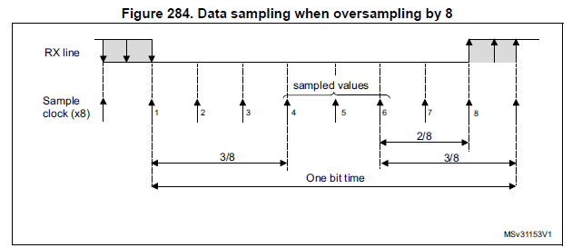
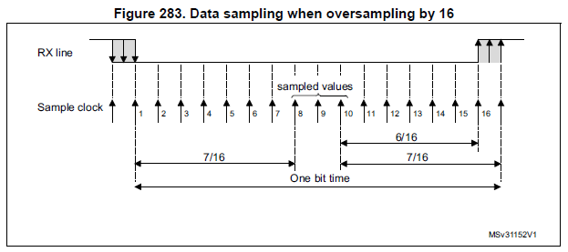
Receiver sampling the data when oversampling by 8 is used
Receiver sampling the data when oversampling by 16 is used
Notes:
STM32F446xx advanced Arm®-based 32-bit MCUs - Reference manual (pg no. 806 & 807)

Slide 53
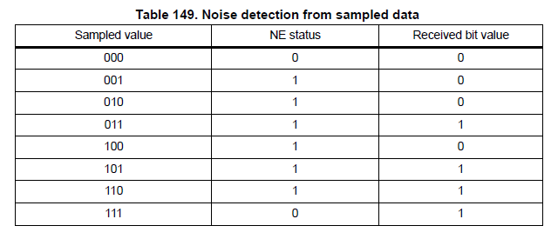
Noise Detection based on Sampled Value
Notes:
STM32F446xx advanced Arm®-based 32-bit MCUs - Reference manual (pg no. 807)

Slide 54
Selecting the proper oversampling method
The oversampling method can be selected by programming the OVER8 bit in the USART_CR1 register and can be either 16 or 8 times the baud rate clock.
Depending on the application:
select oversampling by 8 (OVER8=1) to achieve higher speed (up to fPCLK/8). In this case the maximum receiver tolerance to clock deviation is reduced.
select oversampling by 16 (OVER8=0) to increase the tolerance of the receiver to clock deviations. In this case, the maximum speed is limited to maximum fPCLK/16

Slide 55

Buad rate Calculation
Here,
If OVER8 = 1 then oversampling by 8
If OVER8 = 1 then oversampling by 16
USARTDIV value needs to be derived based on baud rate value.
Notes:
STM32F446xx advanced Arm®-based 32-bit MCUs - Reference manual (pg no. 808)

Slide 56
THANK YOU…

